Slide 1
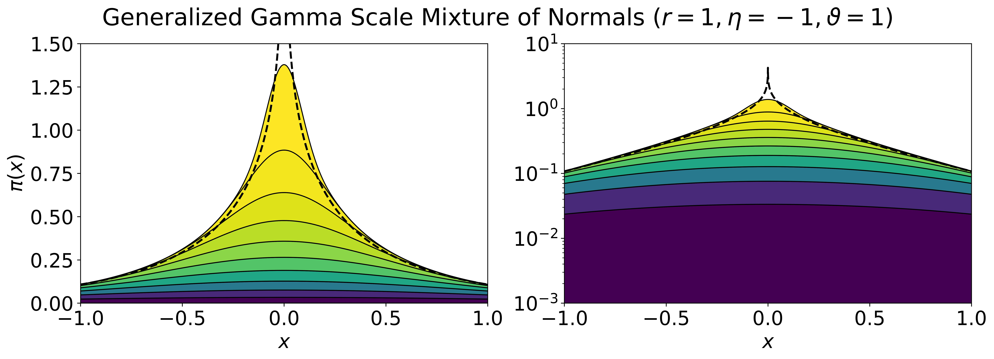
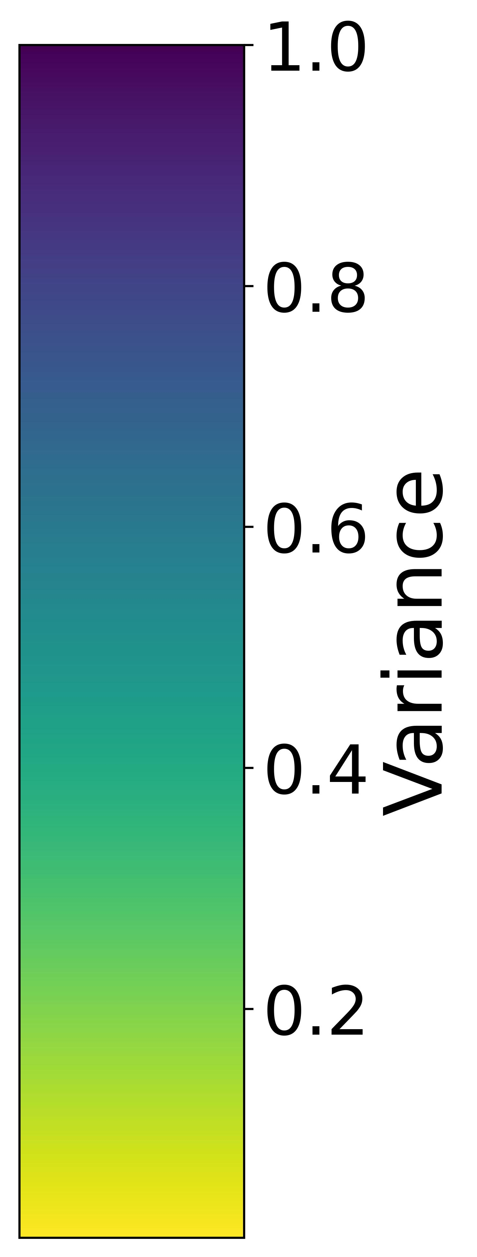

Slide 2
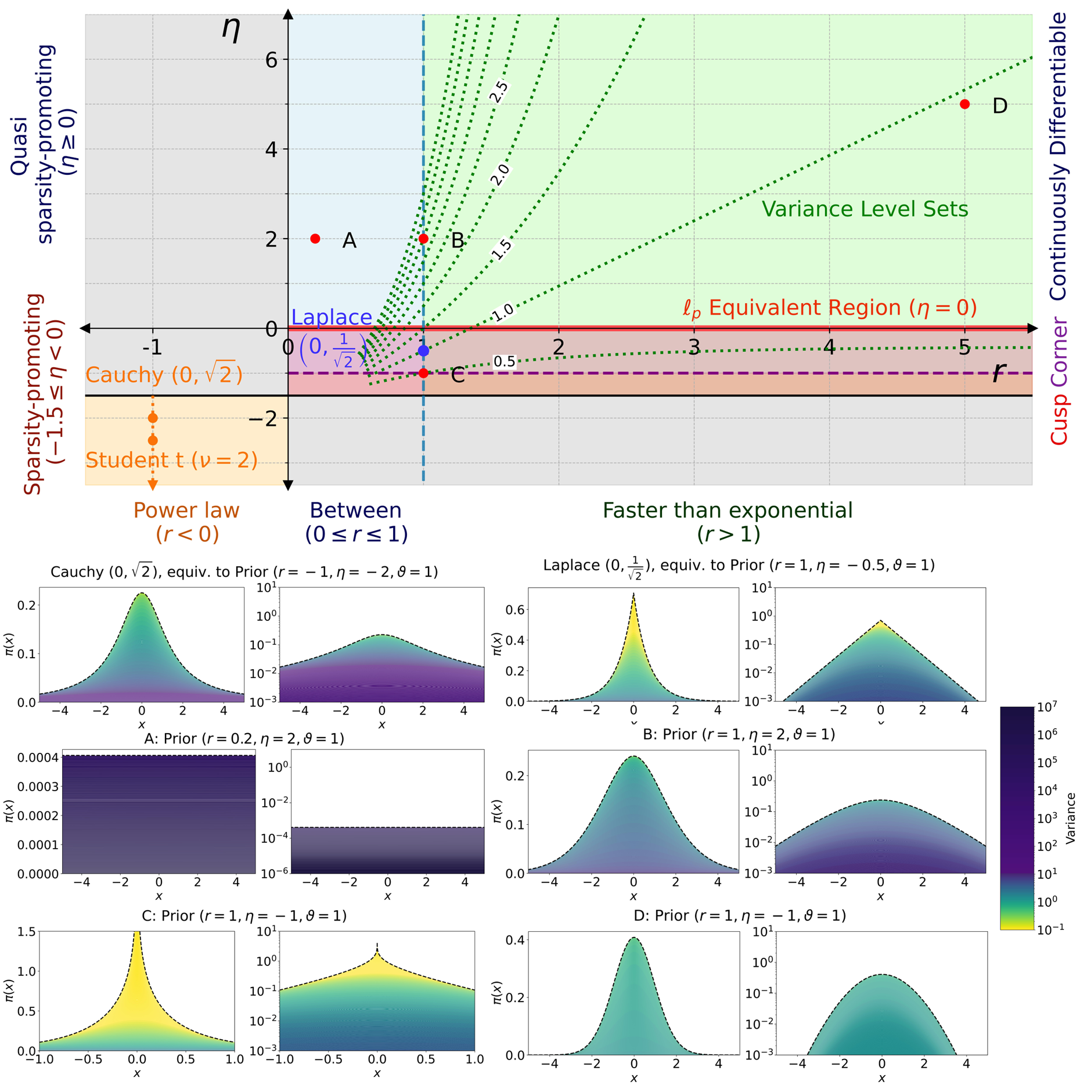
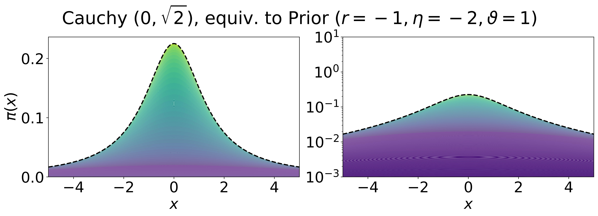
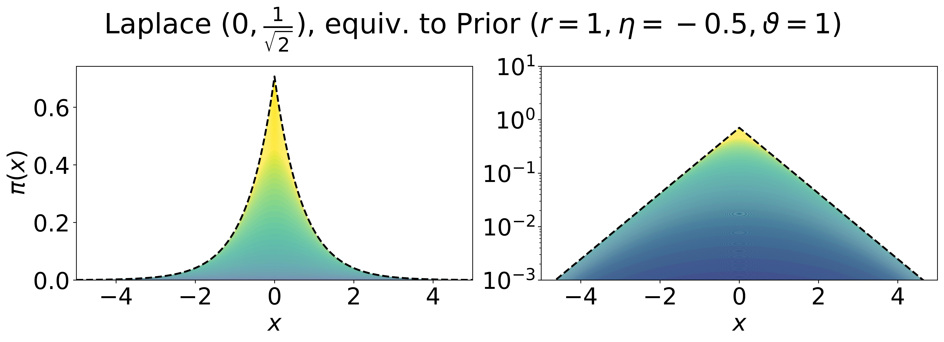
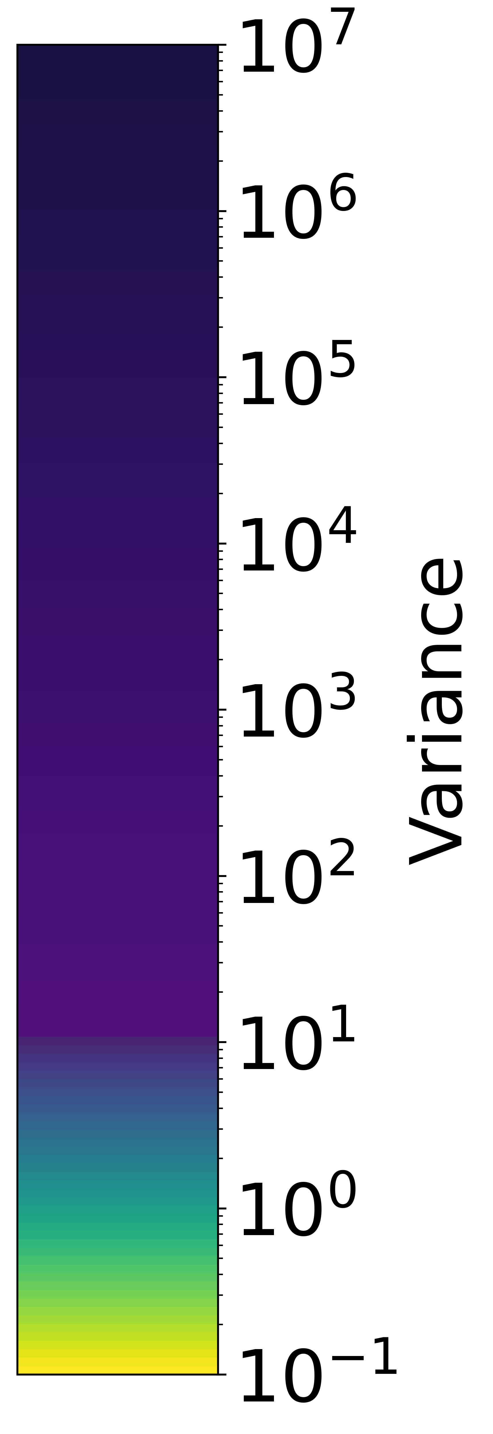
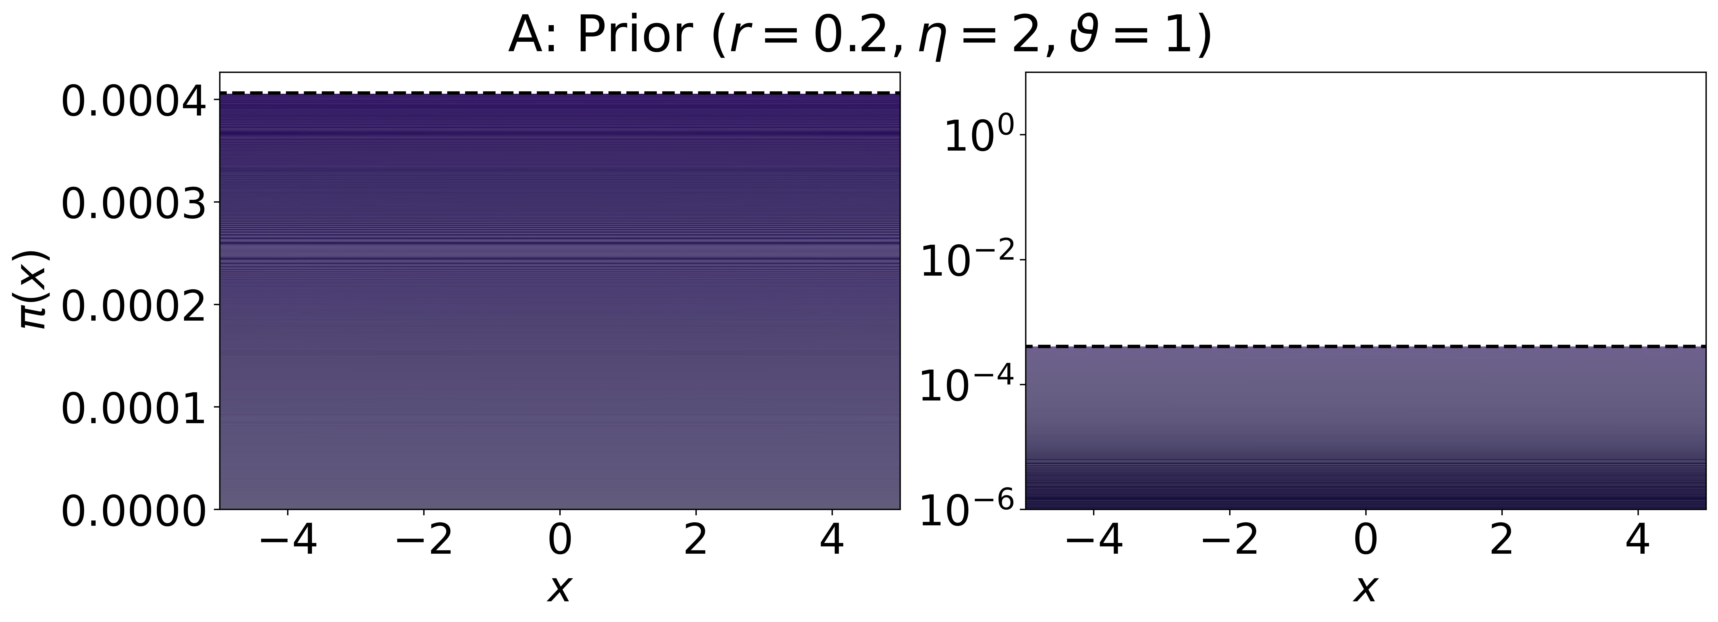
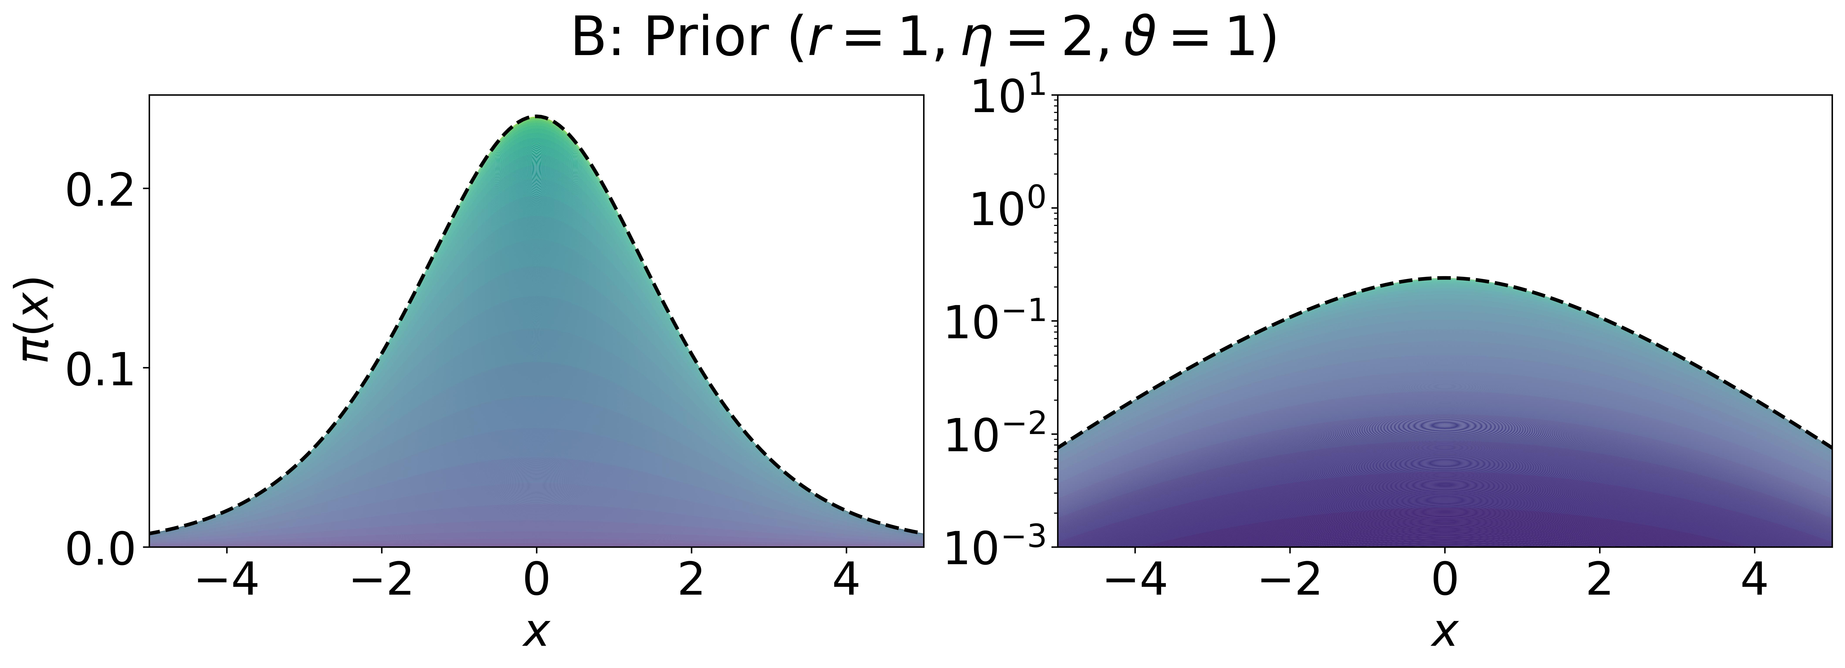
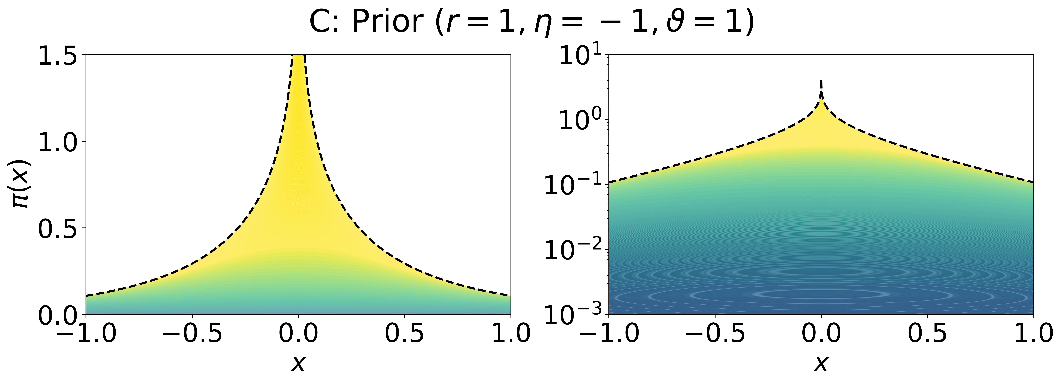
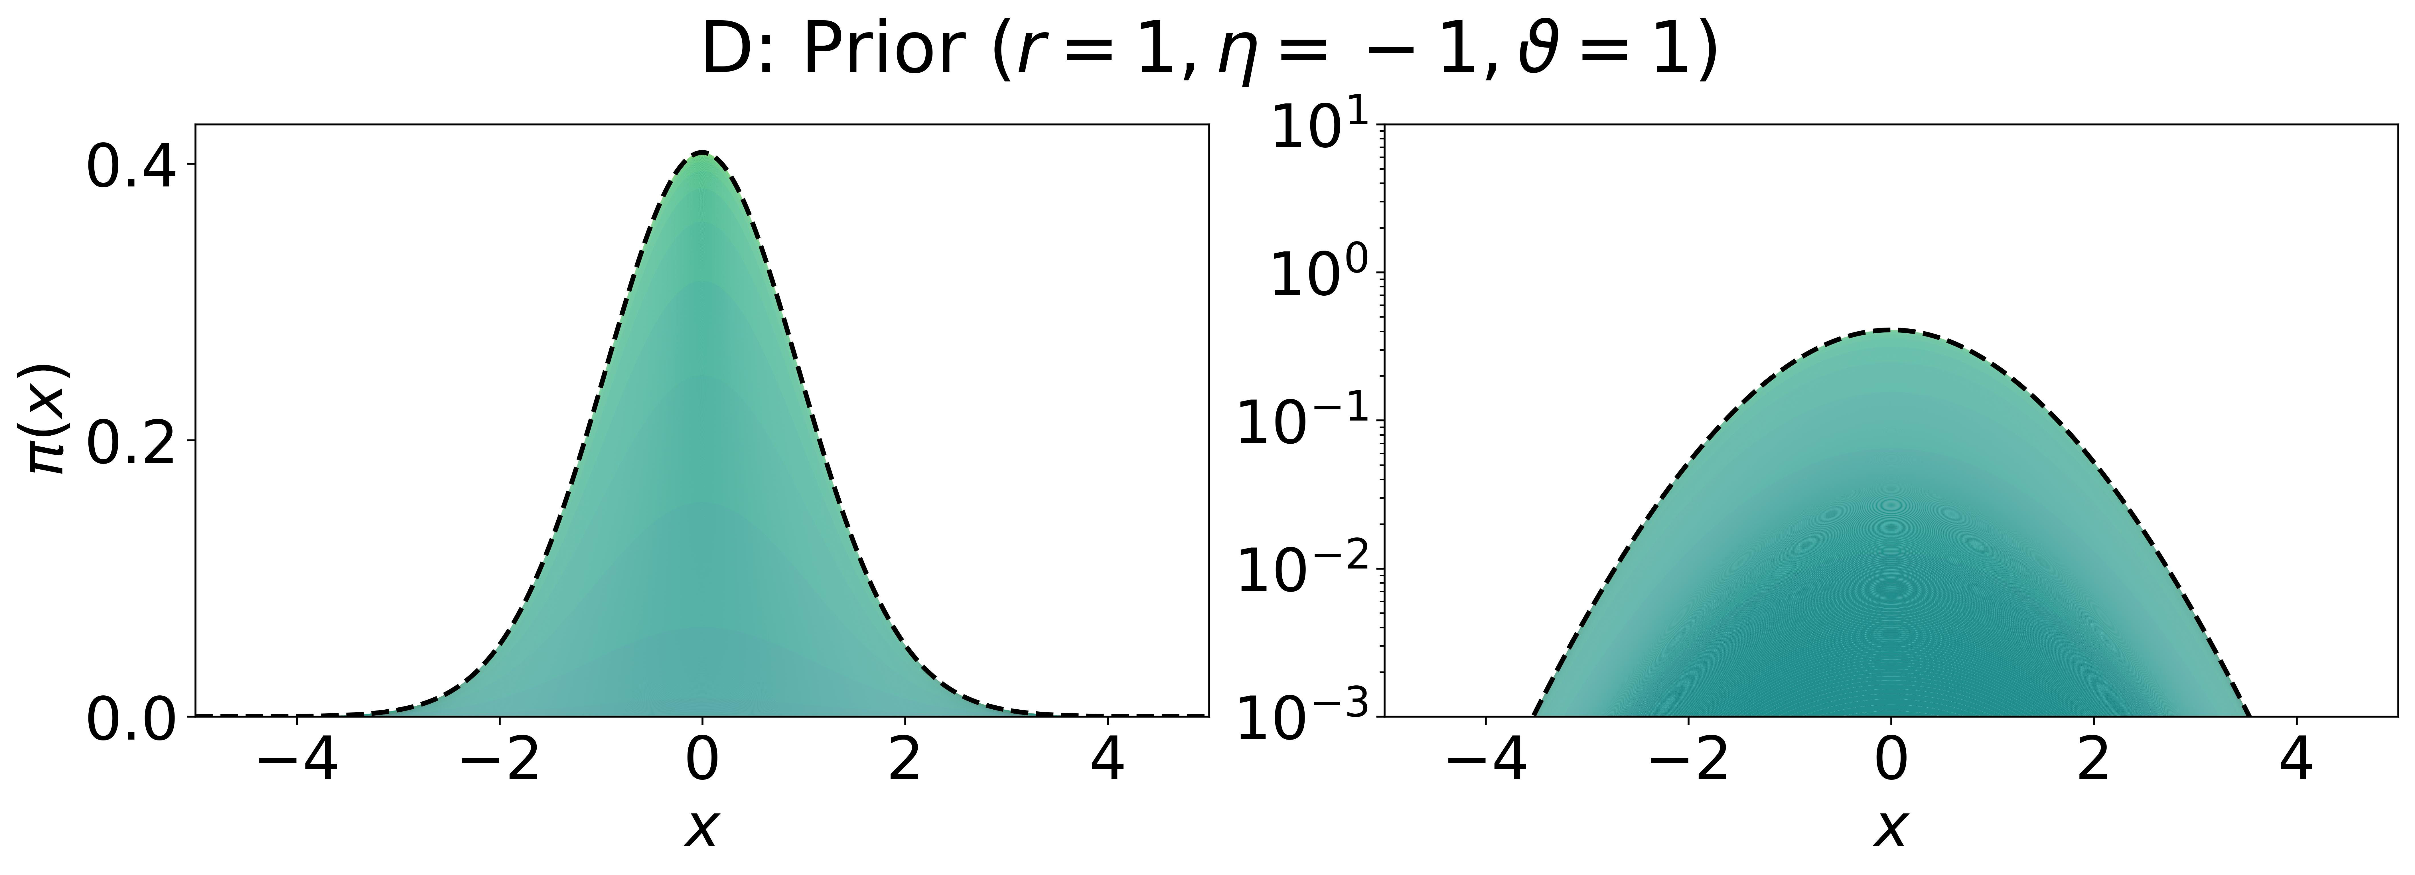

Slide 3
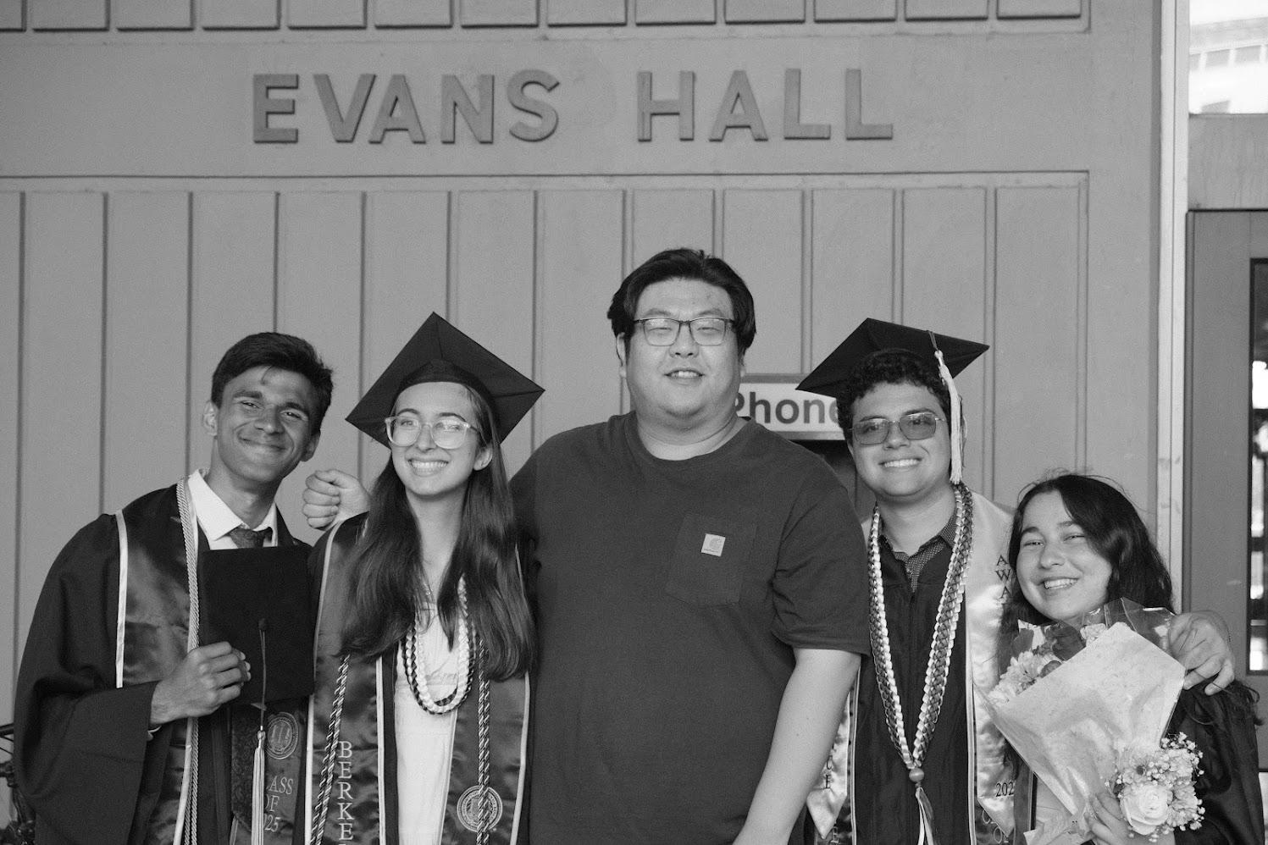
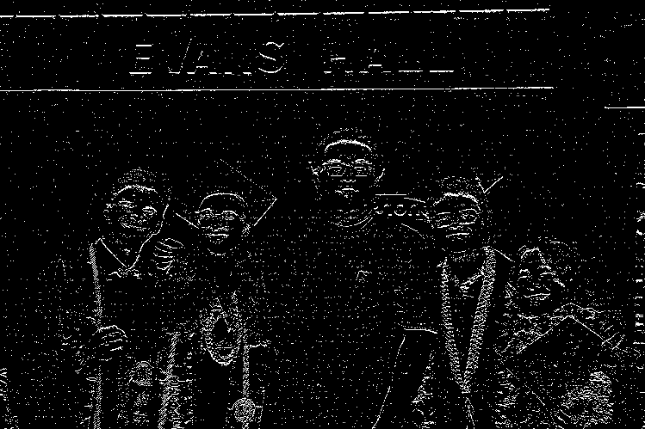
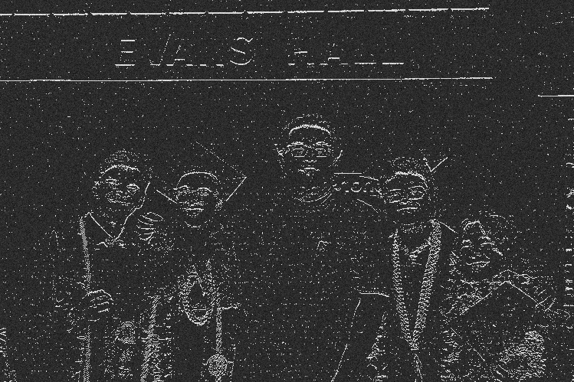
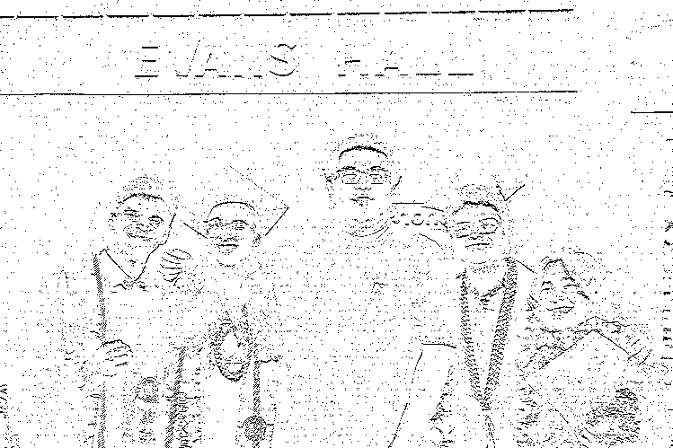
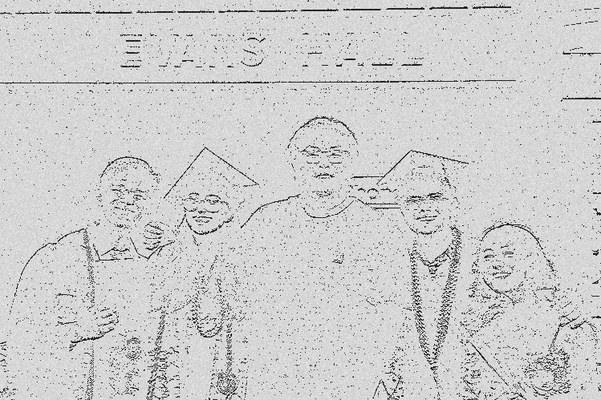
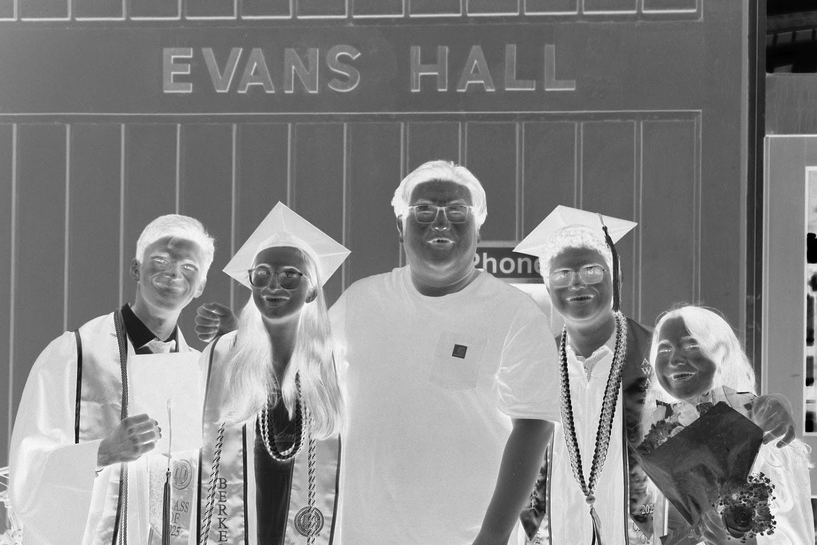


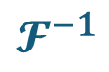
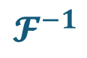
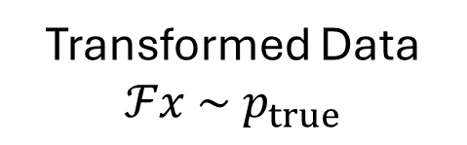



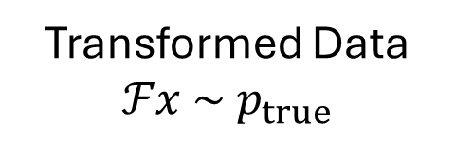
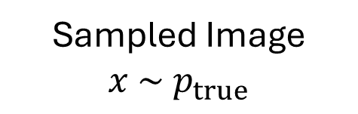
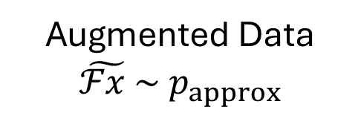
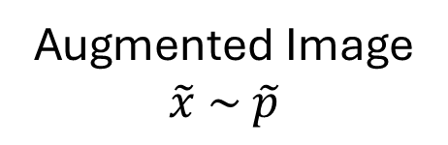
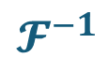

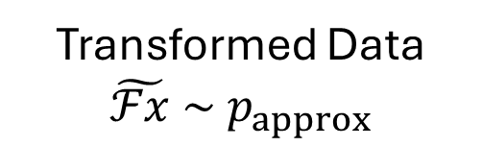
Sampled Image
$$x \sim { p}_{true}$$
Transformed Data
$$ℱx \sim { p}_{true}$$
Observable
$$Y=ℱx+ε$$
$$𝓕$$
$+$Measurement noise$ε$
Ideal Model
$$𝓕^{−1}$$
*Full Bayesian Pipeline
Transformed Data
$$ℱx \sim { p}_{true}$$
Augmented Data
$$\tilde{ℱx }\sim { p}_{approx}$$
$$\tilde{Y}=\tilde{ℱx}+ε$$
*Inverse Data Augmentation
Data Augmentation
Make Observation
Augmentation post hoc
$$𝓕$$
$$𝓕^{−1}$$
*Inverse Data Augmentation
Full Bayesian Pipeline
Augmented Image
$$\tilde{x} \sim \tilde{p}$$
Transformed Data
$$\tilde{ℱx} \sim { p}_{approx}$$
$$\tilde{Y}=\tilde{ℱx}+ε$$
Image Augmentation
Make Observation
$$𝓕$$
Augmentation ante hoc
Inverse Image Augmentation
$$𝓕^{−1}$$
Full Bayesian Pipeline
Notes:
Brandon Version

Slide 4
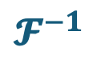


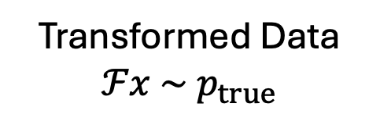

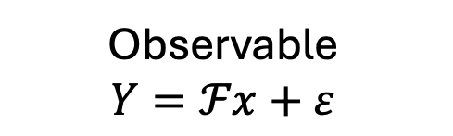
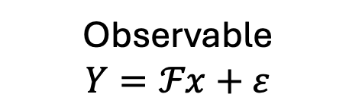
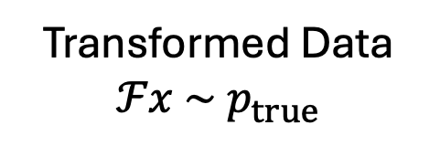
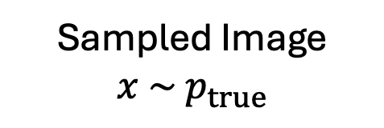
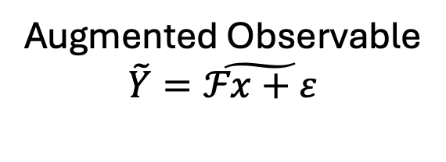
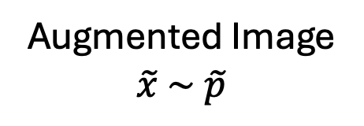
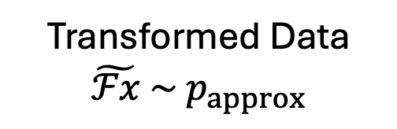
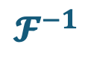
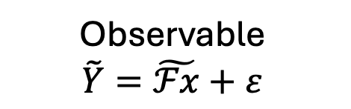
Sampled Image
$$x \sim { p}_{true}$$
Transformed Data
$$ℱx \sim { p}_{true}$$
Observable
$$Y=ℱx+ε$$
$$𝓕$$
$+$Measurement noise$ε$
Ideal Model
$$𝓕^{−1}$$
*Full Bayesian Pipeline
Transformed Data
$$ℱx \sim { p}_{true}$$
Observable
$$Y=ℱx+ε$$
Augmented Observable
$$\tilde{Y}=\tilde{ℱx+ε}$$
*Inverse Data Augmentation
Make Observation
Data Augmentation
Augmentation post hoc
$$𝓕$$
$$𝓕^{−1}$$
Full Bayesian Pipeline
*Inverse Data Augmentation
Augmented Image
$$\tilde{x} \sim \tilde{p}$$
Transformed Data
$$\tilde{ℱx} \sim { p}_{approx}$$
Observable
$$\tilde{Y}=\tilde{ℱx}+ε$$
Image Augmentation
Make Observation
$$𝓕$$
Augmentation ante hoc
Inverse Image Augmentation
$$𝓕^{−1}$$
Full Bayesian Pipeline
Notes:
Strang Version

Slide 5
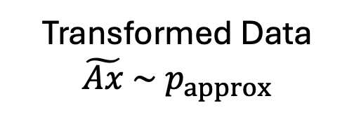
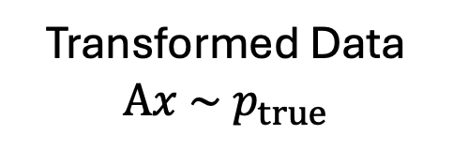
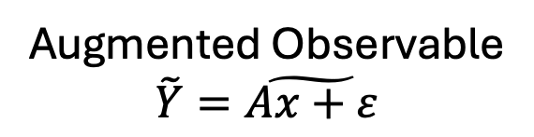


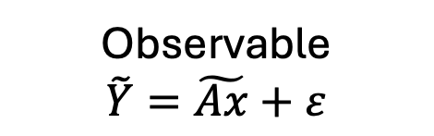
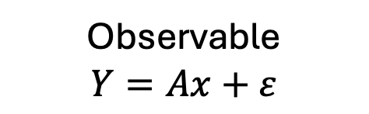
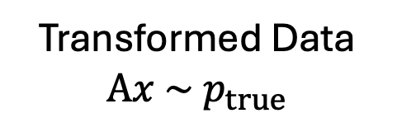
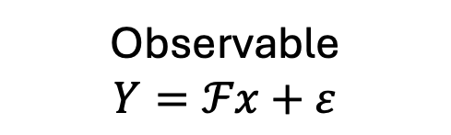

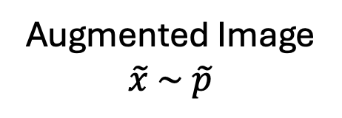
Sampled Image
$$x \sim { p}_{true}$$
Transformed Data
$$Ax \sim { p}_{true}$$
Observable
$$Y=Ax+ε$$
$$A$$
$+$Measurement noise$ε$
Ideal Model
Full Bayesian Pipeline
Transformed Data
$$Ax \sim { p}_{true}$$
Observable
$$Y=ℱx+ε$$
Augmented Observable
$$\tilde{Y}=\tilde{Ax+ε}$$
Data Augmentation
Make Observation
Augmentation post hoc
$$A$$
*Inverse Data Augmentation
Full Bayesian Pipeline
Augmented Image
$$\tilde{x} \sim \tilde{p}$$
Transformed Data
$$\tilde{Ax} \sim { p}_{approx}$$
Observable
$$\tilde{Y}=\tilde{Ax}+ε$$
Image Augmentation
Make Observation
$$A$$
Augmentation ante hoc
Inverse Image Augmentation
Full Bayesian Pipeline
Notes:
Strang Version New letters

Slide 6
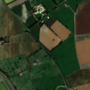
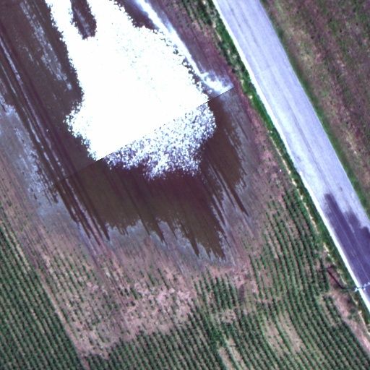
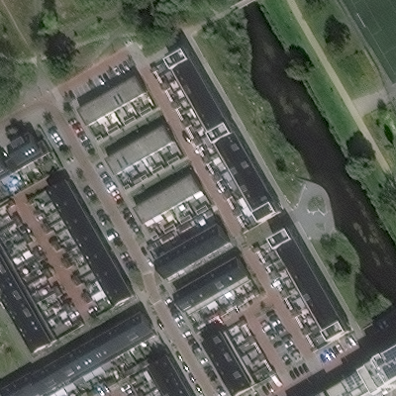
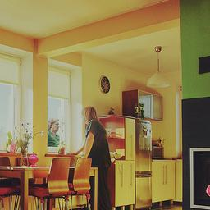
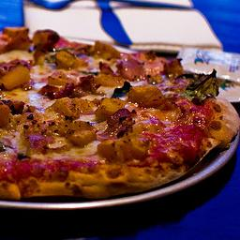

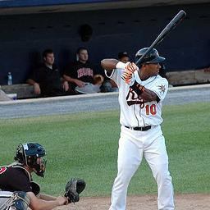






Slide 7











Slide 8


Slide 9






